Slide 1

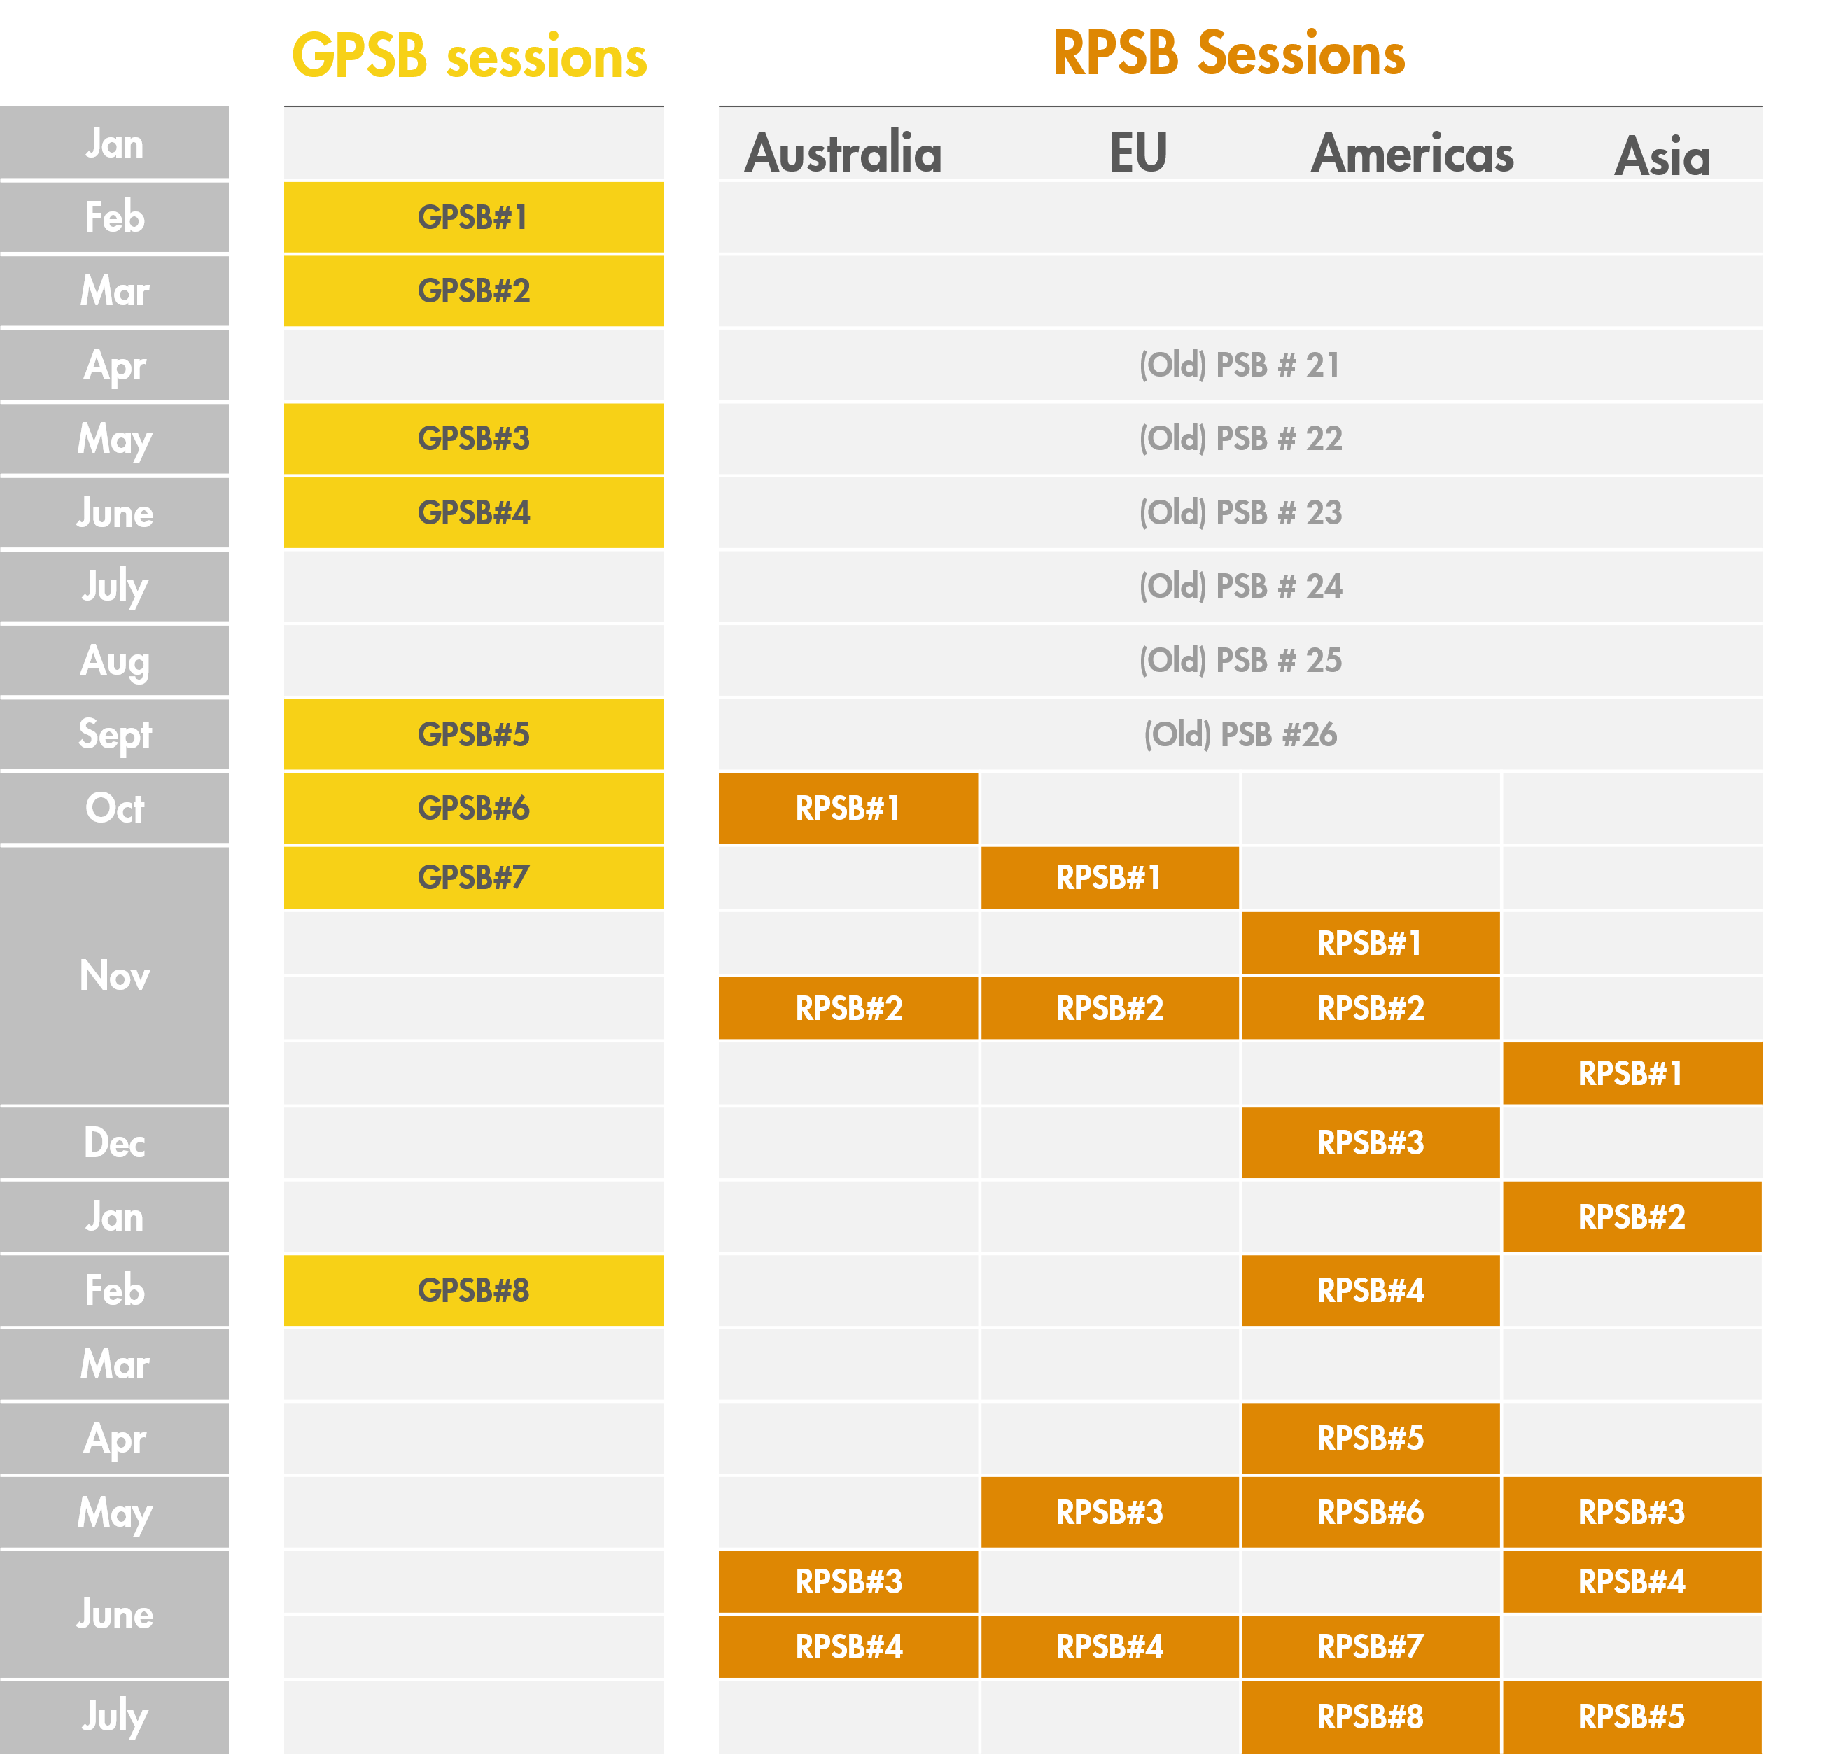
ENERGY & MARKET FUNDAMENTALS
Global Power Fundamentals Analysis and Governance
Or: A story of how to herd a globally dispersed and unaligned group of power fundamentals experts
to deliver high-quality assured and consistent power price scenarios fit-for-purpose for valuation and capital allocation in Shell.
SHAPE
CONNECT
ACCELERATE
Marcelo, Clara, Eric, Esther & Flora
SCA Global Team F2F 2026 | 7–8 September
The Importance of Global Power Fundamentals Scenarios and Analysis for Shell
The Challenge. An internal audit in 2022 concluded that the existing framework of global power fundamentals suffered from serious issues due to inconsistencies in methodologies across the different modelling teams, lack of clarity / alignment on governance, and limited assurance on the work done and the price curves that were delivered.
The Purpose. A Project was established in 2023 to create a robust framework for developing consistent long-term power price scenarios, fit-for-purpose, and with an appropriate level of independence from valuation/deal making process.
The Architecture. Senior members from Shell Energy, Finance & Strategy formed the DRB, overseeing the work to be implemented in two equally important tracks: Analysis and Governance. New structure went live on Jan 2025.
Analysis track
Governance track
Creation of the Global Shell Power Scenarios Reference, Ambition and Endurance as comprehensive narratives to ensure global consistency while allowing for regional specificity.
Close collaboration between SIS Power Fundamentals and regional Shell Energy teams ensures global consistency and local specificities are aligned.
Clear and fit-for-purpose deliverables agreed with the Global/Regional Power Sounding Boards and published in the economics PSV portal (power prices, RES generation, grid emissions, etc. )
Globally consistent and aligned improvement roadmaps including e.g., detailed modeling of battery duration, weather years, demand flexibility, e-mobility, data centers, version control, validation, non-energy markets, etc.
Governance structure in two-layers allows for global alignment while exploiting regional expertise:
Global Power Sounding Board (GPSB, chaired by Laszlo) establishes implementation of best practices and a joint roadmap.
Regional Power Sounding Boards (RPSBs, chaired by VP Shell Energy for Asia, Australia, Americas, Europe) apply regional expertise to challenge and approve power scenarios and prices.
Ambition
Reference
Endurance
Successful implementation of ambitious policies drive technology innovation and give the power system a central position in society.
Central view on current trends and policies balancing competing concerns on cost, climate and security with most likely technological improvements.
A fragmented and messy evolution guided by market forces and powerful incumbents rather than policy. Geopolitical tensions result in a focus on national security.
RV Gas, Coal, CO2 PSVs
RV Gas, Coal, CO2 PSVs
& HV, SV Sensitivities
RV Gas, Coal, CO2 PSVs
Schedule of GPSBs and RPSBs that took place over the course of 2025 and 2026 (so far) which led to the delivery and approval of Power scenarios and Power PSVs (Project Screening Values) in 2025 Q2, 2025 Q4, 2026 Q2 for all Shell Energy regions: 6 markets in Europe, 6 markets in the Americas, 2 in Australia, 3 in Asia.
Key Achievements and Learnings
Globally consistent power price scenarios. Since 2025 Q2, the framework has delivered power price scenarios that are globally consistent, built over a common narrative, considering regional specificities and local business needs across Australia, Asia, Europe, and the Americas.
Strong and Fluid Governance helps. A key learning is that a fluid governance process that allows dynamic improvements on a global scale and flexibility to capture local specificities provides a very good framework to produce quantitative results that are fit-for-purpose and methodologically sound.
Engine for continuous improvement and learning across teams and regions. The framework provides the engine to improve and learn across the global community with the SCA Power team as center of global expertise.
Shape. Connect. Accelerate.
September 7–8, 2026

